Slide 1

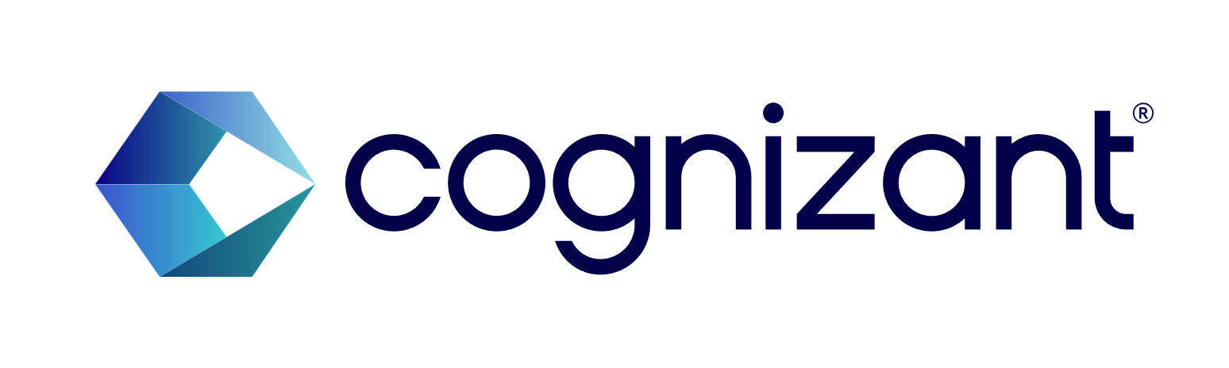
ADM Insurance Hackathon 2024
Idea – 88238
PROTOTYPE PHASE
Title: Future Forward
Creator(s) : Md Kamran Uddin

Slide 2

Summary of Idea
Gen AI Theme: Legacy Modernization
Summary of the Idea – There are legacy applications in the project which can be modernized to enhance the user experience as well as help the developers align the project with current technologies and make it feasible for the client to achieve better productivity.
The idea is to modernize and re-develop the current application which is a legacy project build on SOAP webservices with the new technology stack involving Spring Boot and REST webservices.
The following slides explain about SOAP & REST and the different implementations for both which shows us the advantages of REST over SOAP.

Slide 3
What is the difference between SOAP and REST?
SOAP and REST are two internet data exchange mechanisms. For example, imagine that our internal accounts system shares data with our customer's accounting system to automate invoicing tasks. The two applications share data by using an API that defines communication rules. SOAP and REST are two different approaches to API design. The SOAP approach is highly structured and uses XML data format. REST is more flexible and allows applications to exchange data in multiple formats.
To build applications, we can use many different programming languages, architectures, and platforms. It’s challenging to share data between such varied technologies because they have different data formats. Both SOAP and REST emerged in an attempt towards solving this problem.

Slide 4
Cont.
We can use SOAP and REST to build APIs or communication points between diverse applications. The terms web service and API are used interchangeably. However, APIs are the broader category. Web services are a special type of API.
Here are other similarities between SOAP and REST:
They both describe rules and standards on how applications make, process, and respond to data requests from other applications
They both use HTTP, the standardized internet protocol, to exchange information
They both support SSL/TLS for secure, encrypted communication
We can use either SOAP or REST to build secure, scalable, and fault-tolerant distributed systems.

Slide 5
Key differences: SOAP vs REST
 | SOAP | REST
Stands for | Simple Object Access Protocol | Representational State Transfer
What is it? | SOAP is a protocol for communication between applications | REST is an architecture style for designing communication interfaces.
Design | SOAP API exposes the operation. | REST API exposes the data.
Transport Protocol | SOAP is independent and can work with any transport protocol. | REST works only with HTTPS.
Data format | SOAP supports only XML data exchange. | REST supports XML, JSON, plain text, HTML.

Slide 6
Cont.
 | SOAP | REST
Performance | SOAP messages are larger, which makes communication slower. | REST has faster performance due to smaller messages and caching support.
Scalability | SOAP is difficult to scale. The server maintains state by storing all previous messages exchanged with a client. | REST is easy to scale. It’s stateless, so every message is processed independently of previous messages.
Security | SOAP supports encryption with additional overheads. | REST supports encryption without affecting performance.
Use case | SOAP is useful in legacy applications and private APIs. | REST is useful in modern applications and public APIs.

Slide 7
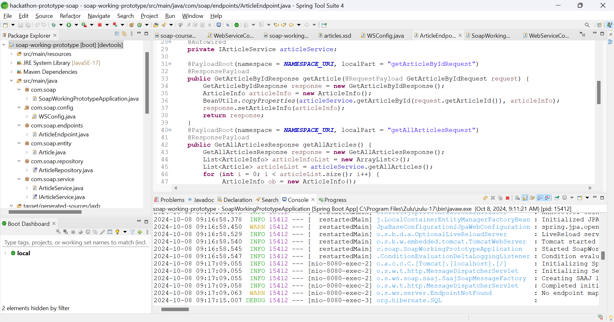
SOAP Implementation

Slide 8
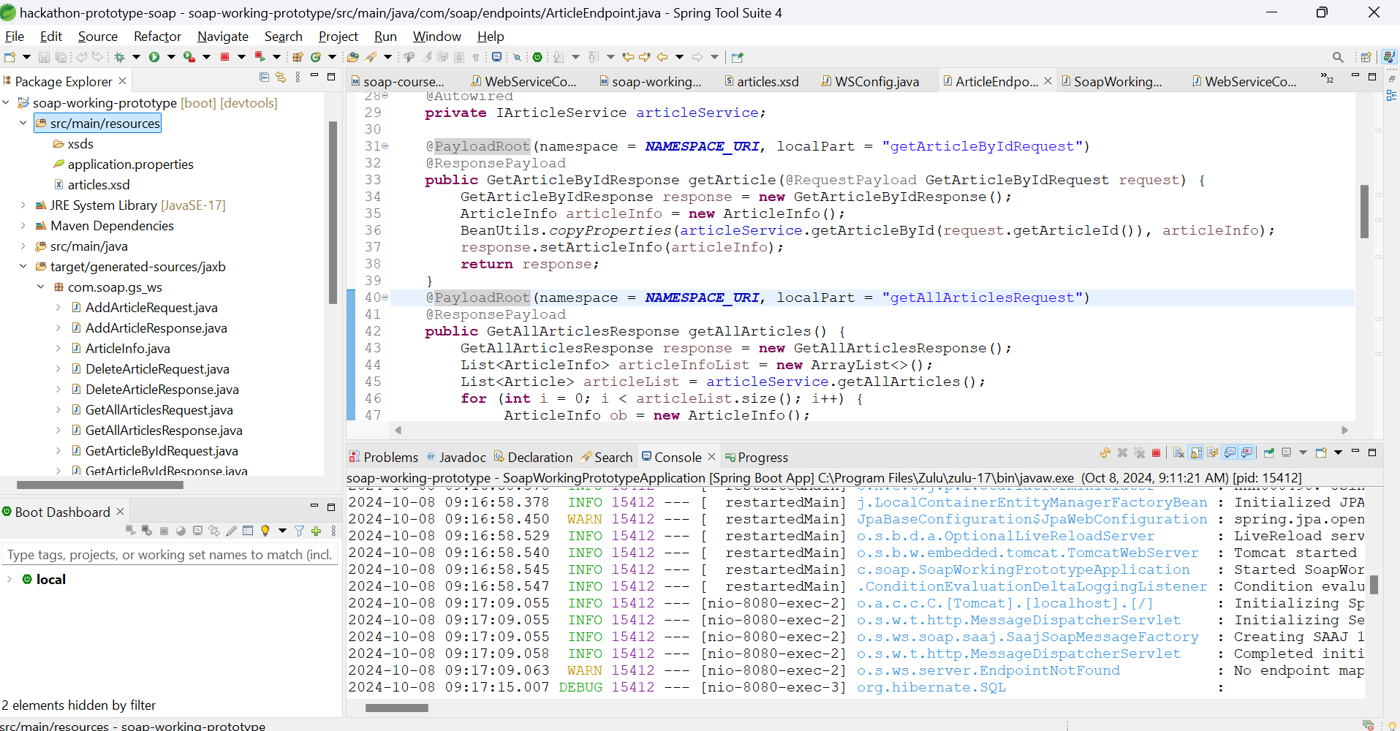
Cont.

Slide 9
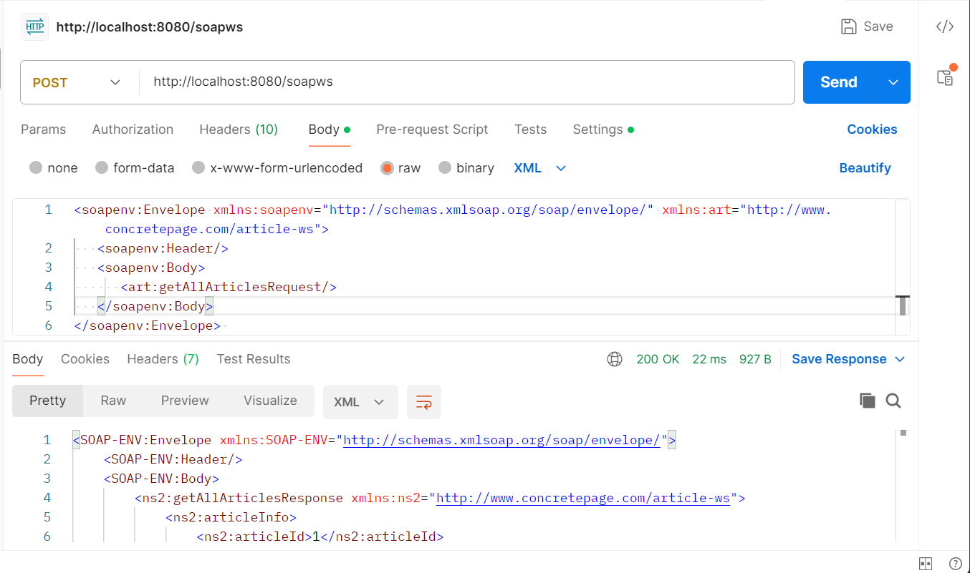
SOAP Request & Response

Slide 10
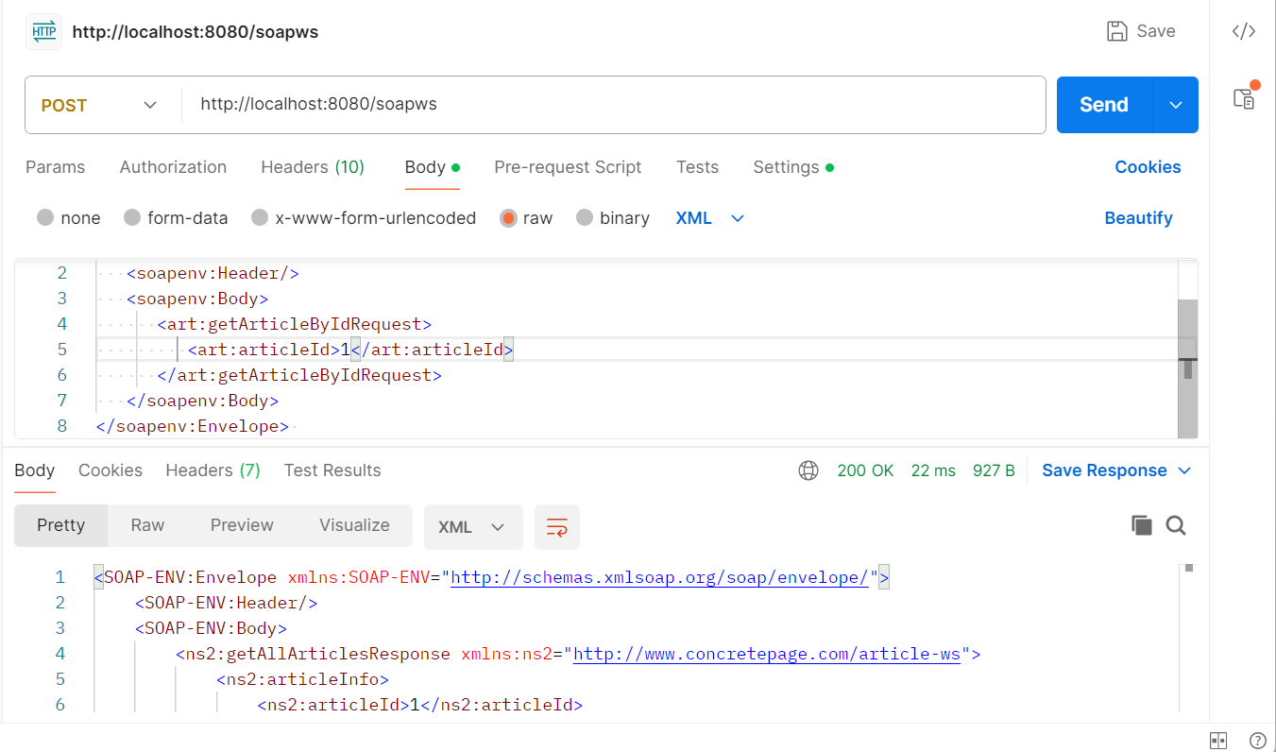
Cont.

Slide 11
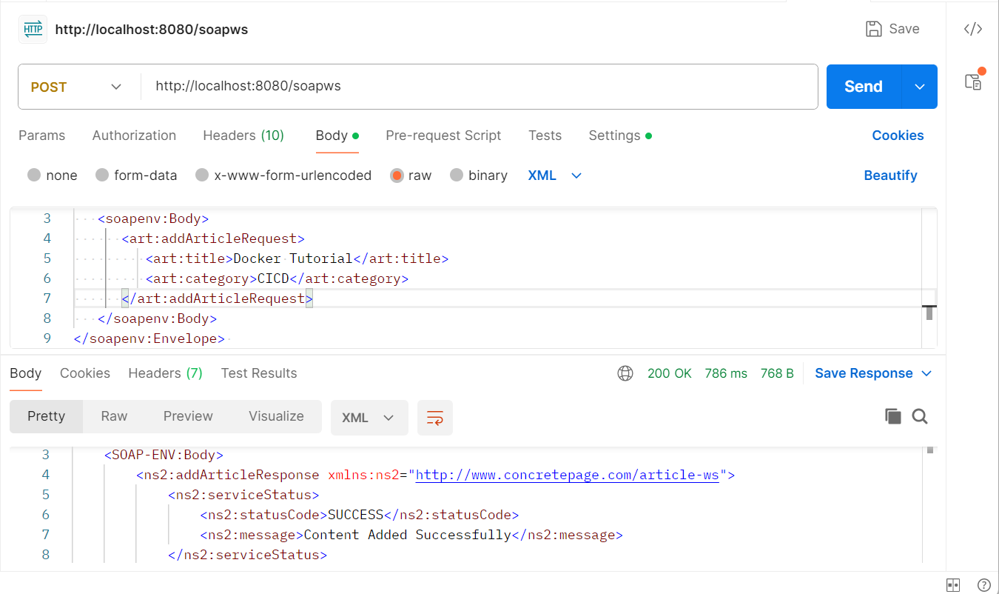
Cont.

Slide 12
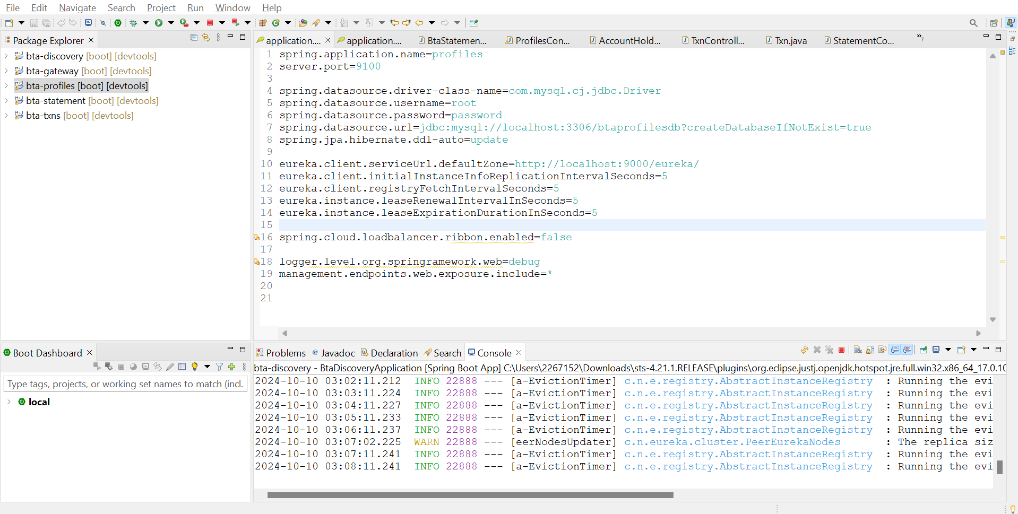
REST with Spring Boot & Microservices Implementation

Slide 13
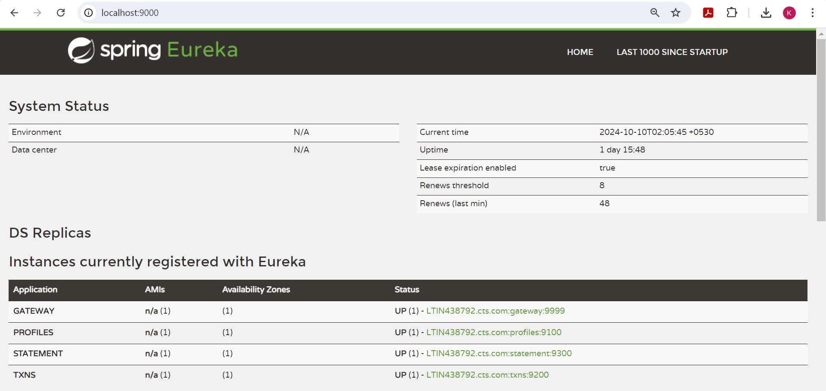
Cont.

Slide 14
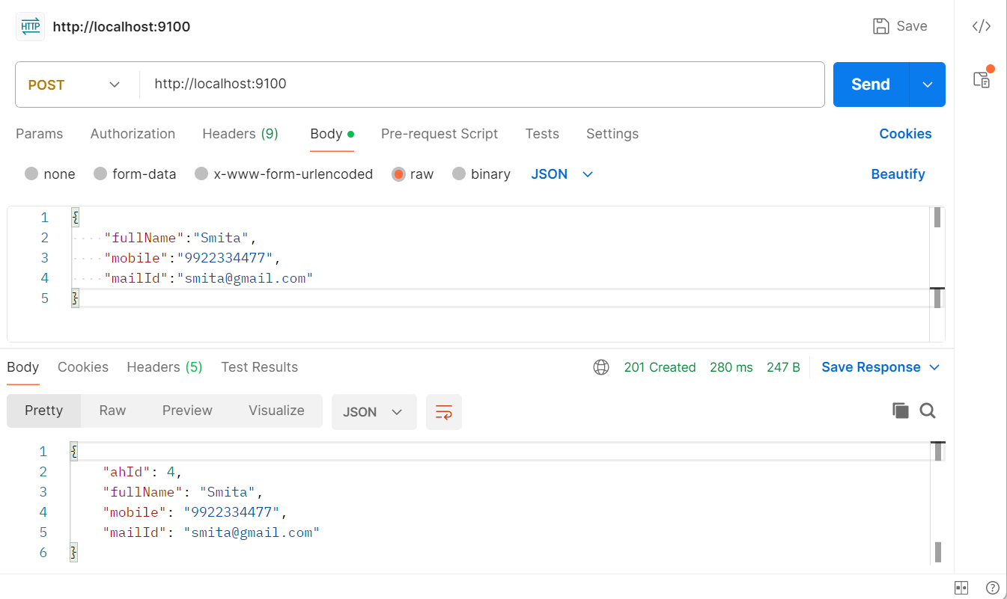
REST Request & Response

Slide 15
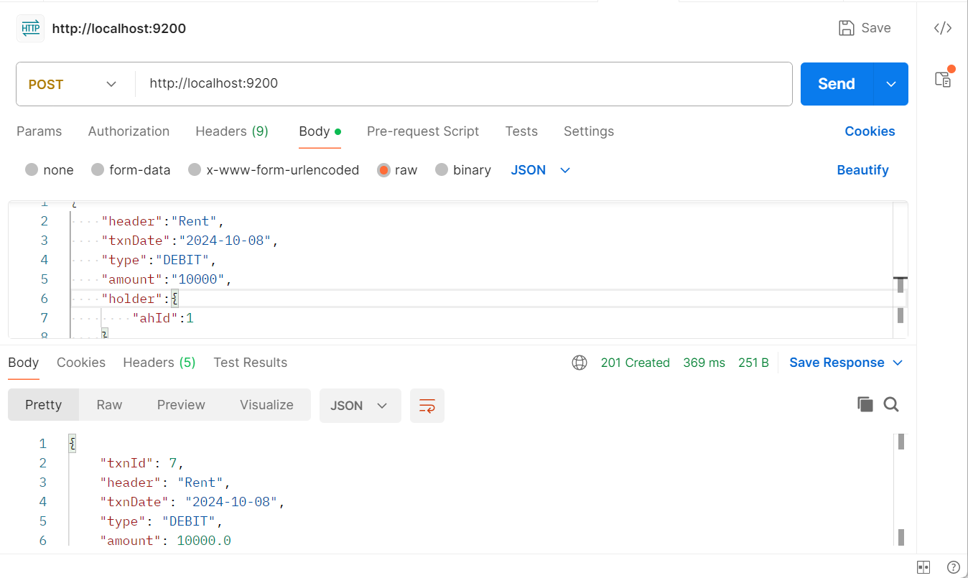
Cont.

Slide 16
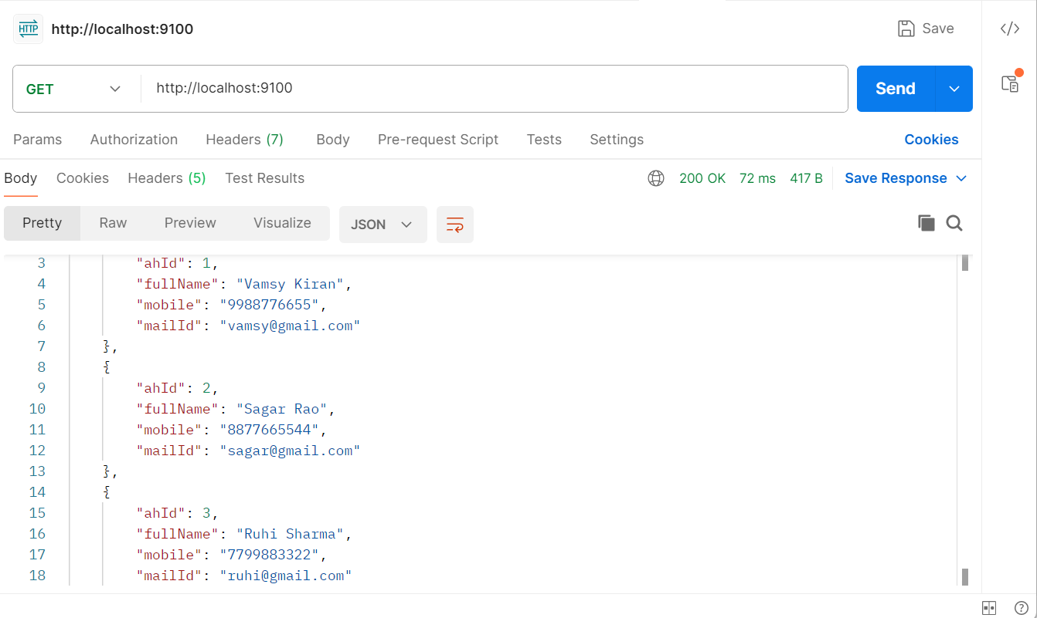
Cont.

Slide 17
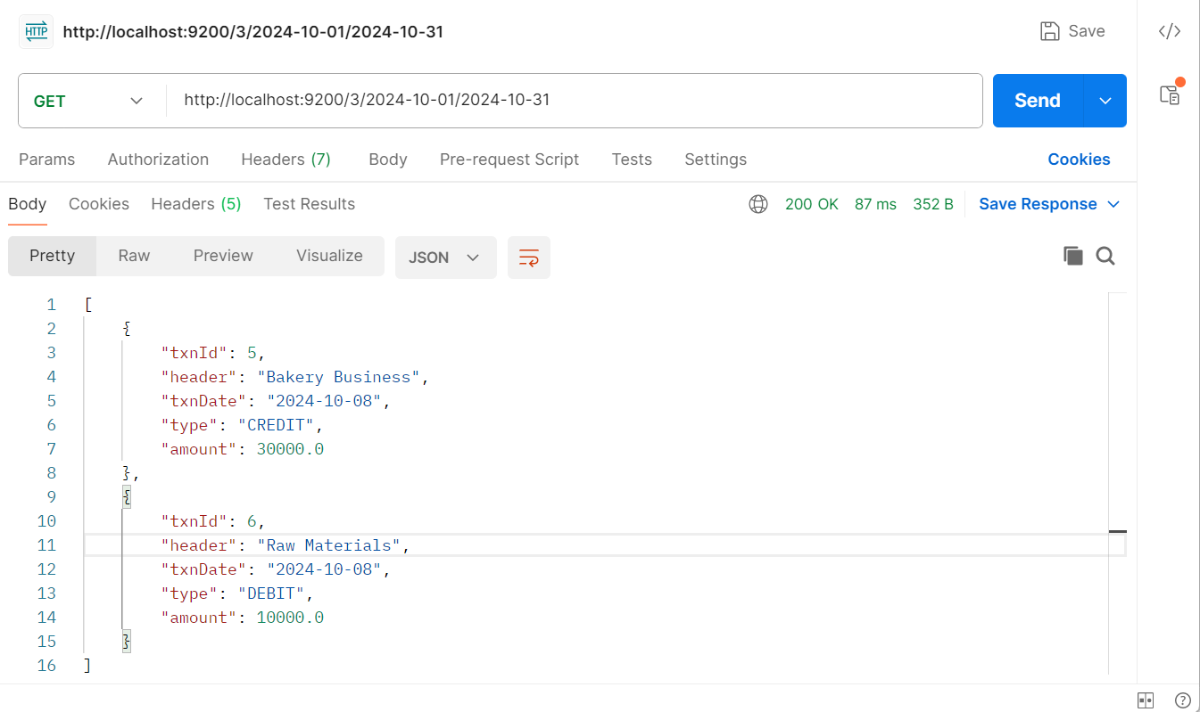
Cont.

Slide 18
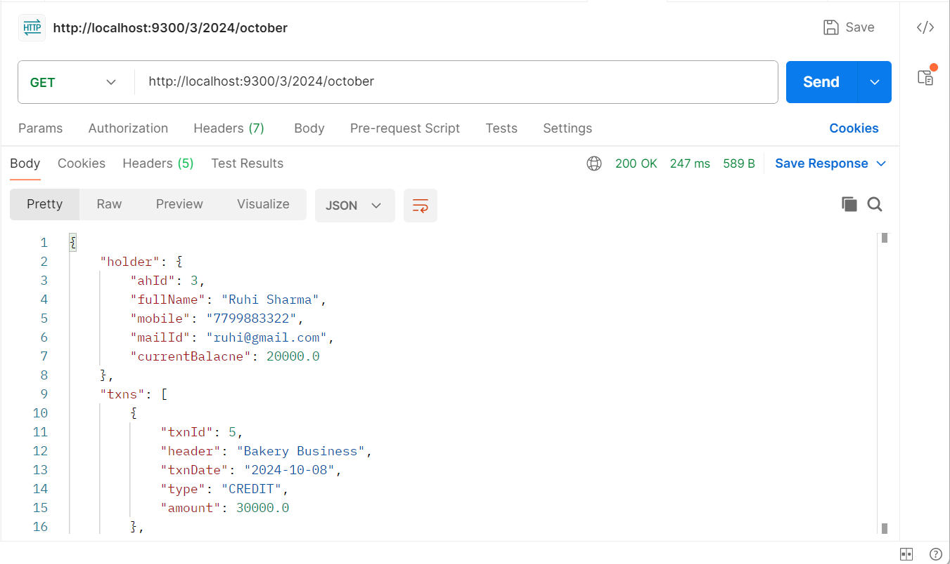
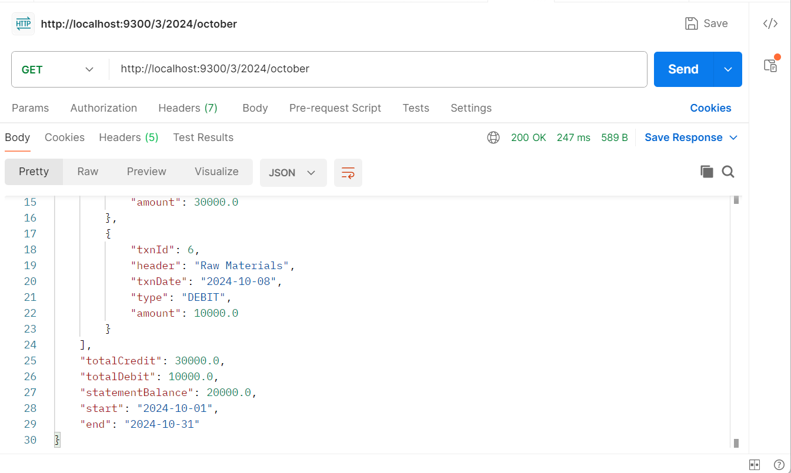
Cont.

Slide 19
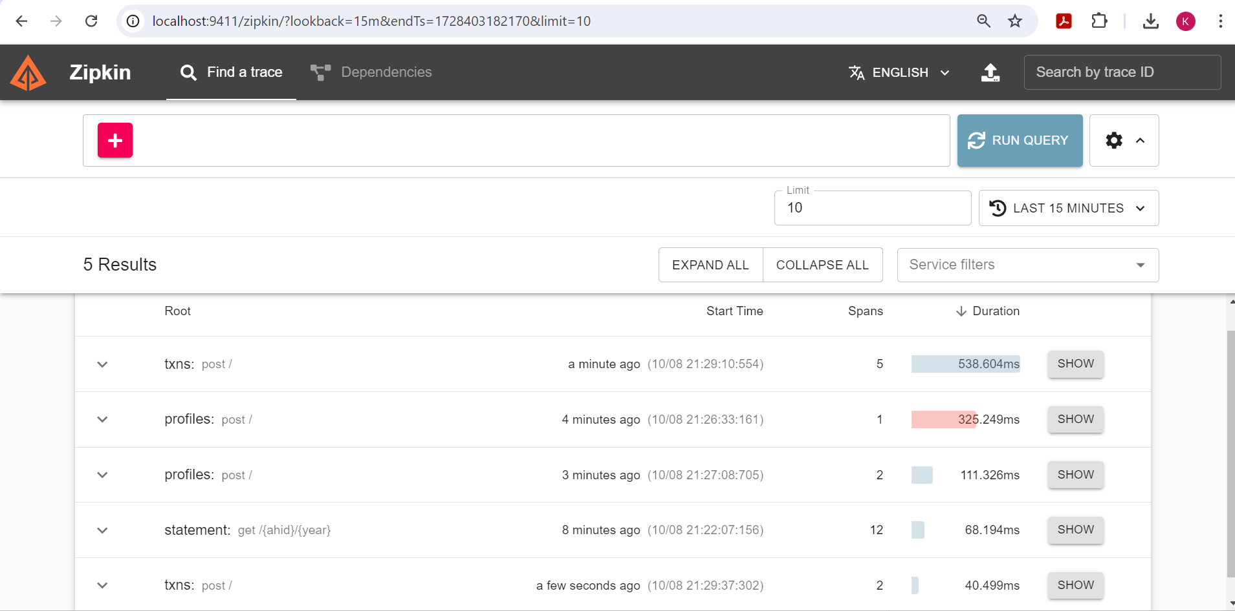
Integrated Tracing Involved

Slide 20
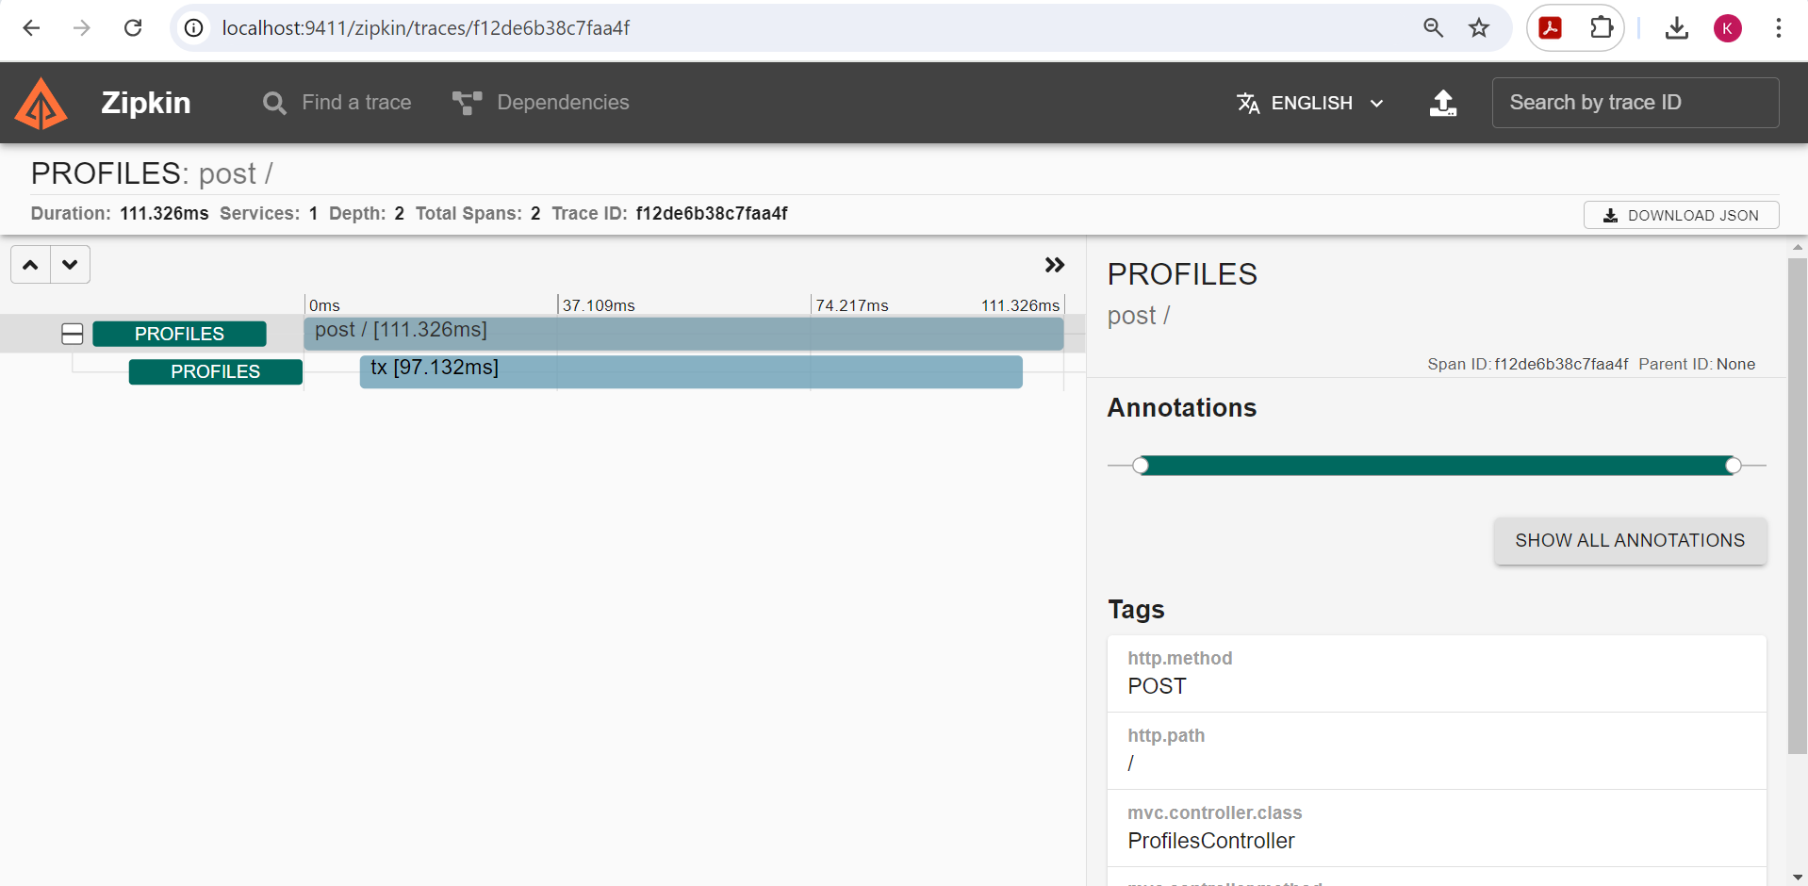
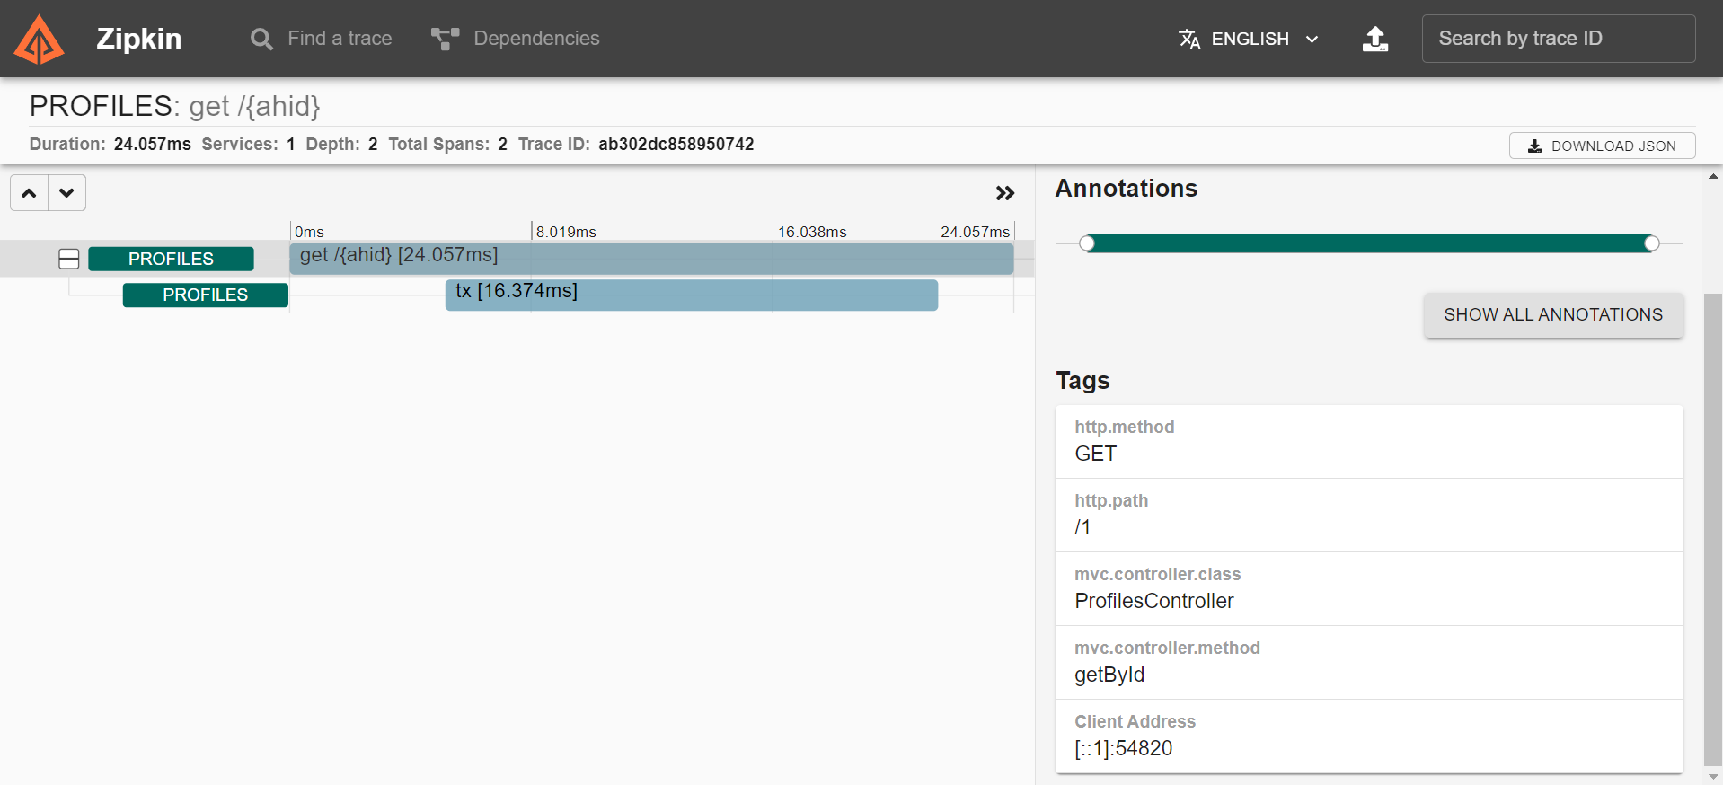
Cont.

Slide 21
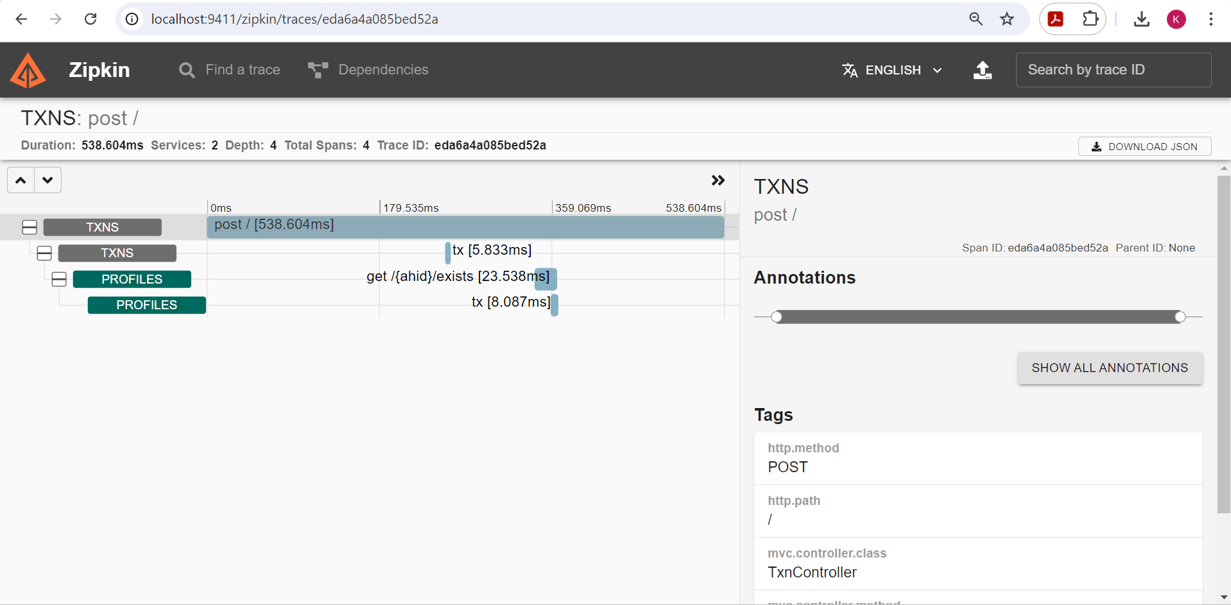
Cont.

Slide 22
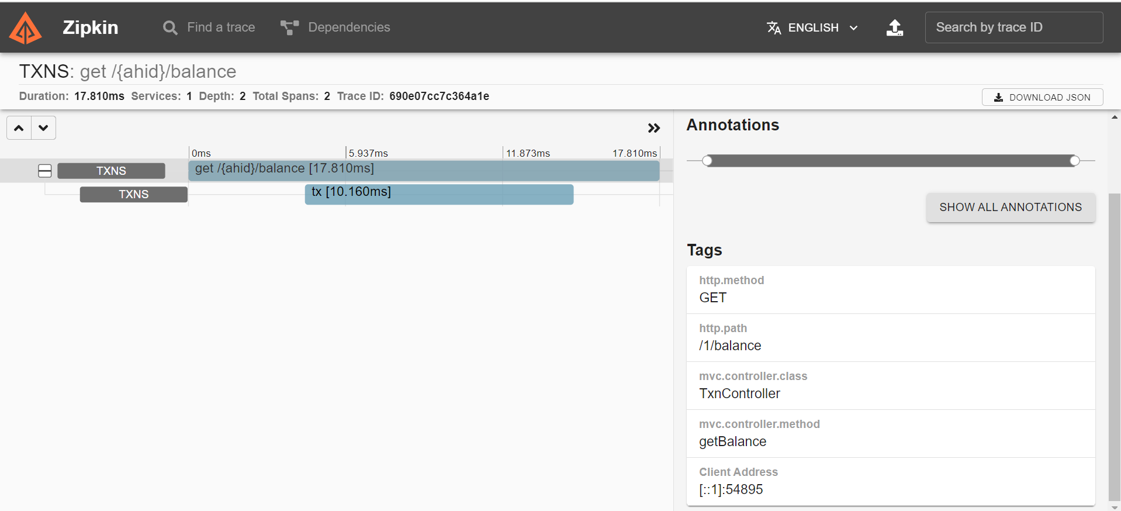
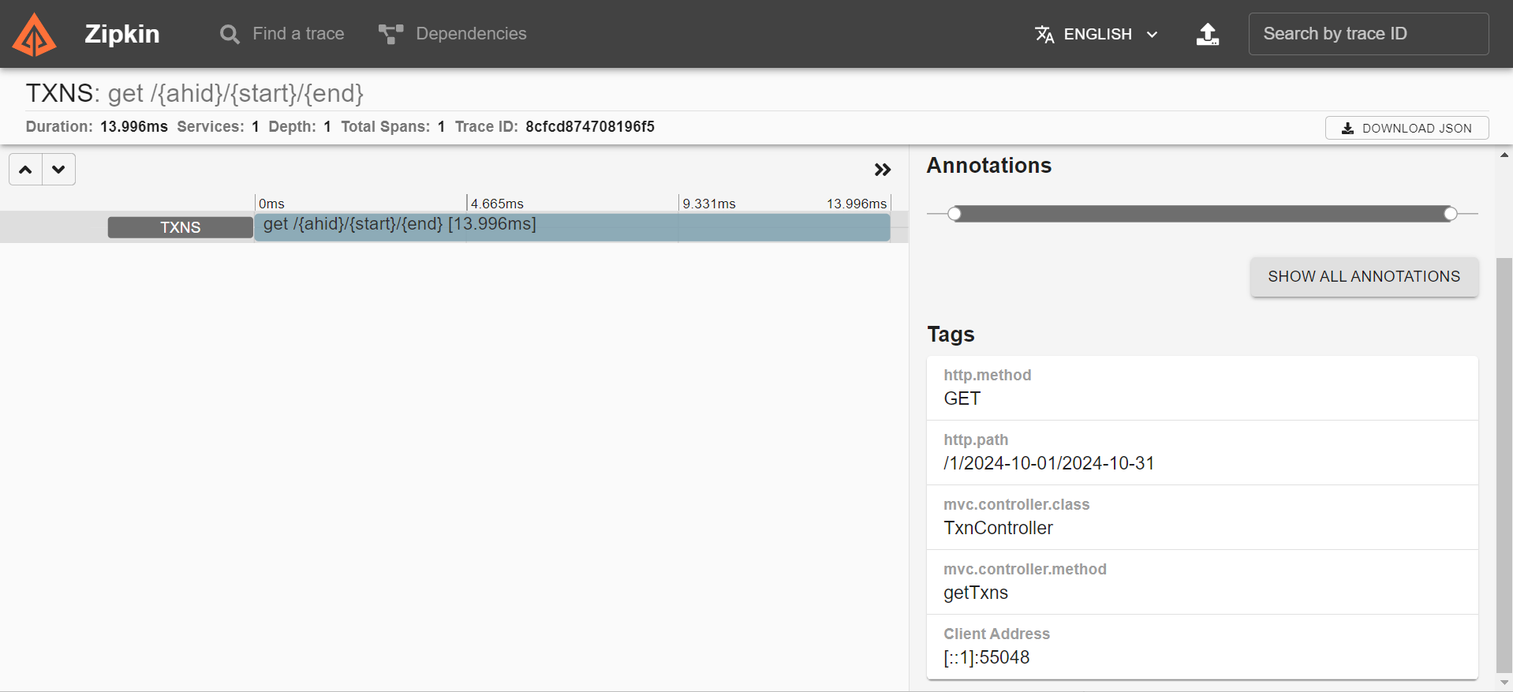
Cont.

Slide 23
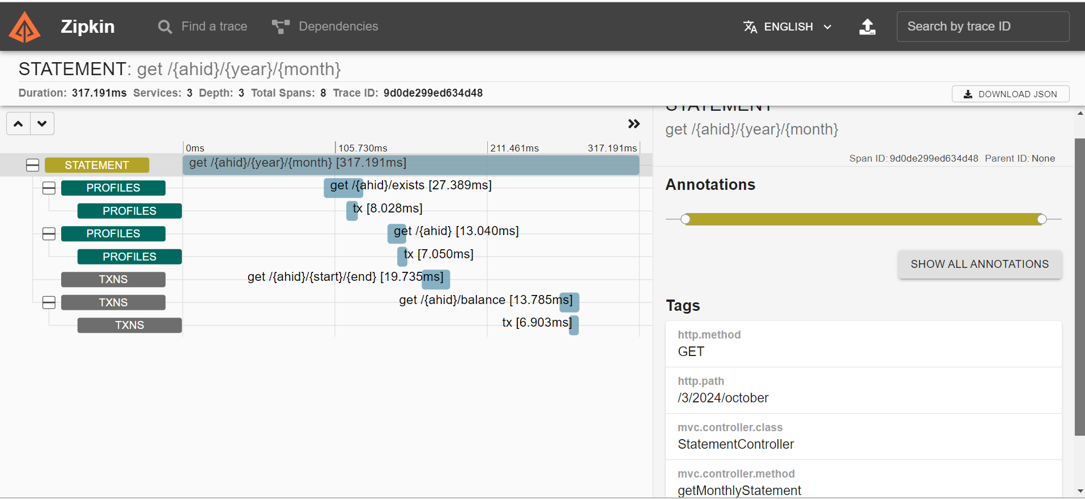
Cont.

Slide 24
Copilot Usage
Create entity classes with parameterized constructor, getters and setters using the fields provided for different entities as per the application design.
Create and design database tables/data models.
Create test cases for controller and service classes.
Write documentation for the application as a whole and on service level methods as well.

Slide 25
Thank you

